Slide 1
Asset Management with Barcode Tagging System for Operations and Maintenance
De Guzman, Joanna
Mayor, Miguel
Tobias, Adrian

Slide 2
Abstract:
In handling bulks of weather stations and their data, effectively organizing and handling data is significantly important to reduce data redundancy and data loss. To achieve efficient organization and handling of data, implementation of an Asset Management System is important to be able to keep information about the weather stations such as ID number, weather station name, location, etc. Also, a Preventive Maintenance System is strictly recommended to be implemented to, as the name implies, prevent the weather station from malfunctioning or having errors occur. This study will explain the benefits of implementing an asset management system, as well as a preventive maintenance system in the Operations and Maintenance Department of Weather.ph to efficiently and effectively handle the data and information about the weather stations of the company around the regions of the Philippines.

Slide 3
Introduction:
Creating a new algorithm that would improve upon the old existing system for the company called Weather.ph
What is Weather.ph?
What do they do?

Slide 4
Objectives:
The researchers of the study have decided that the following are the main specific objectives of the study:
- To improve the algorithm to a better and faster way which would minimize the delay of accessing the information.
- To come up with a proposal of usable methods that can lead into create a software that will solve the problem of Weather.com.ph completely
- To create a software solution which solves the inefficiency in the Operations and Maintenance department

Slide 5
Scope and Limitations:
The study will not cover other departments such as Financial Department and Human resources and limited to the Operations & Maintenance Department.
Limited to the improvement of the old system by proposing a new software solution, which provides convenience and increase in productivity in the Operations and Maintenance department of the company.

Slide 6
Technical Background:
Created with the Yii2 Framework
PHP Coding as well as some MySQL Database management
Consists of Weather Station entry CRUD, Service Report Handling CRUD, Scheduling and Barcode generation for the specific Weather Station
Accessible by mobile, computer and tablet devices

Slide 7
Design and Methodology
The group of processes or the order of our whole system is the following:
1. Data Quality Team checks if a weather station is broken
2. If there is a broken weather station, creates a service request
3. The service request is sent to the technicians
4. Technicians will execute maintenance referring to the service request received
5. Technicians will do first solution first and if first solution doesn’t work, do second solution
6. First solution is contacting site manager for maintenance through phone and the call is recorded
7. If it doesn’t work, second solution is mandatory and it is a site visit for physical maintenance
8. Scheduling is a first before a site visit
9. After maintenance, a service report is created to mark the end of the maintenance process
10. The service report is then passed to the Operations and Maintenance Head for review and double checking for error
11. End of the process

Slide 8
Review of Related Literature
Weather Station
Barcode
RFID vs. Barcode
Preventive Maintenance
Asset Management

Slide 9
What else to implement
Unified data base for files
Job assignment and management
Scheduling via calendar
Notification and Instant Messaging
Admin upgrade in user management

Slide 10
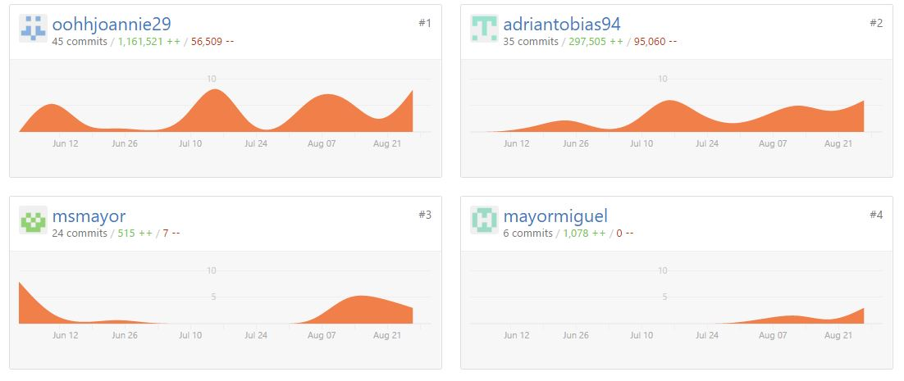
GITHUB

Slide 11
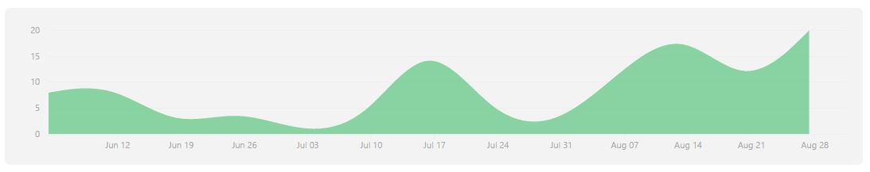

Slide 12
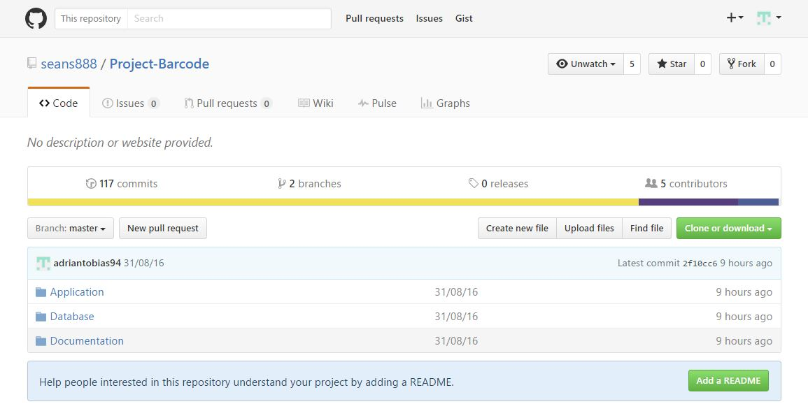

Slide 13
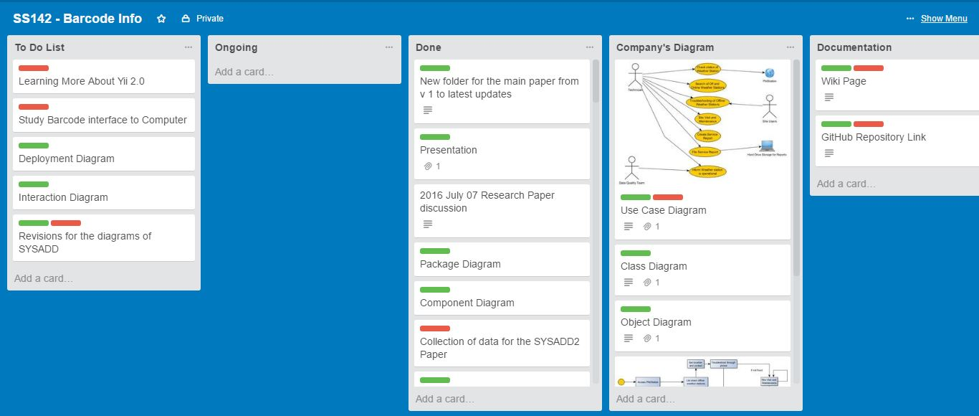
TRELLO

Slide 14
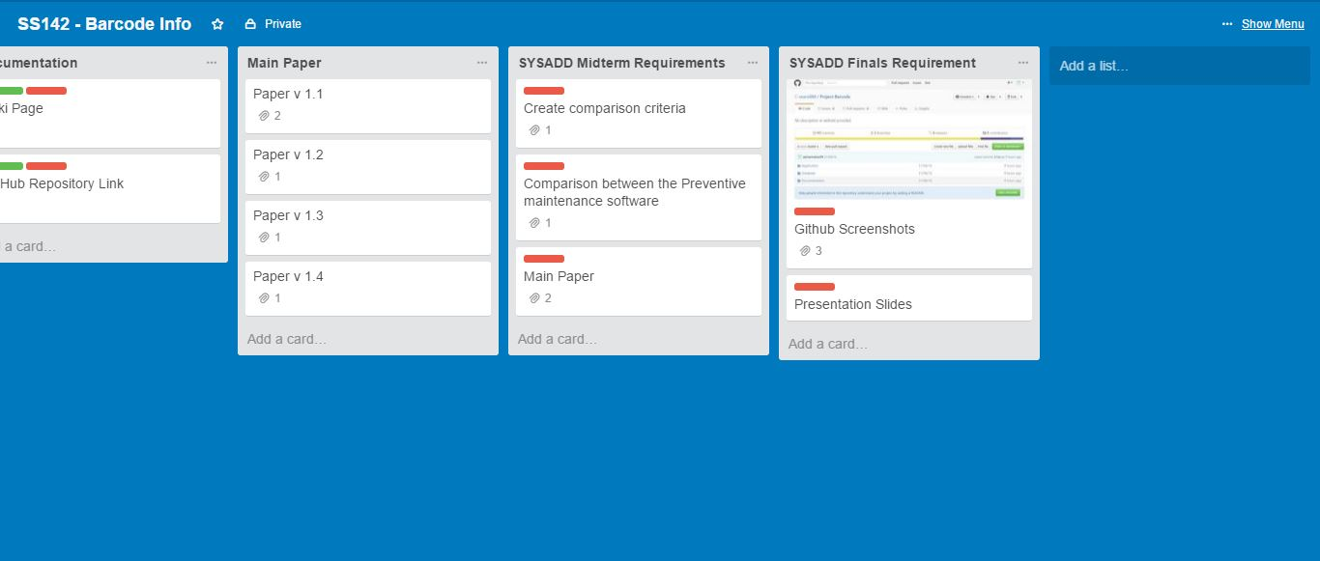

Slide 15
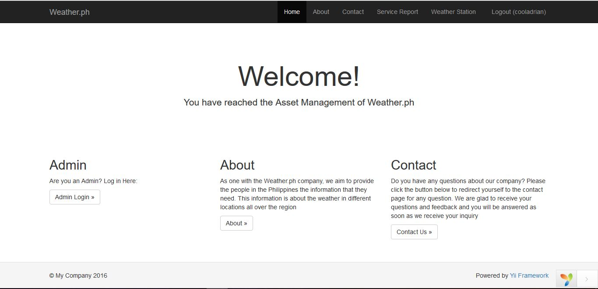
FRONTEND

Slide 16
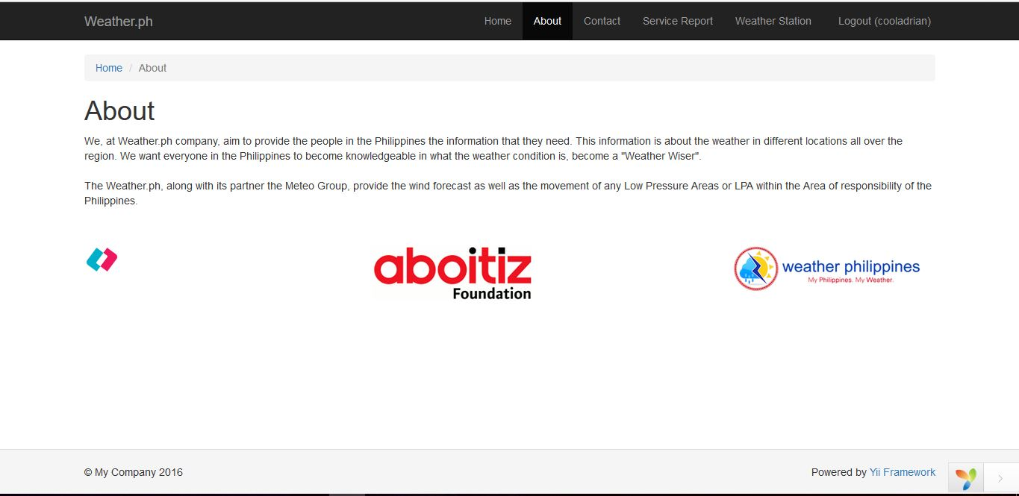

Slide 17
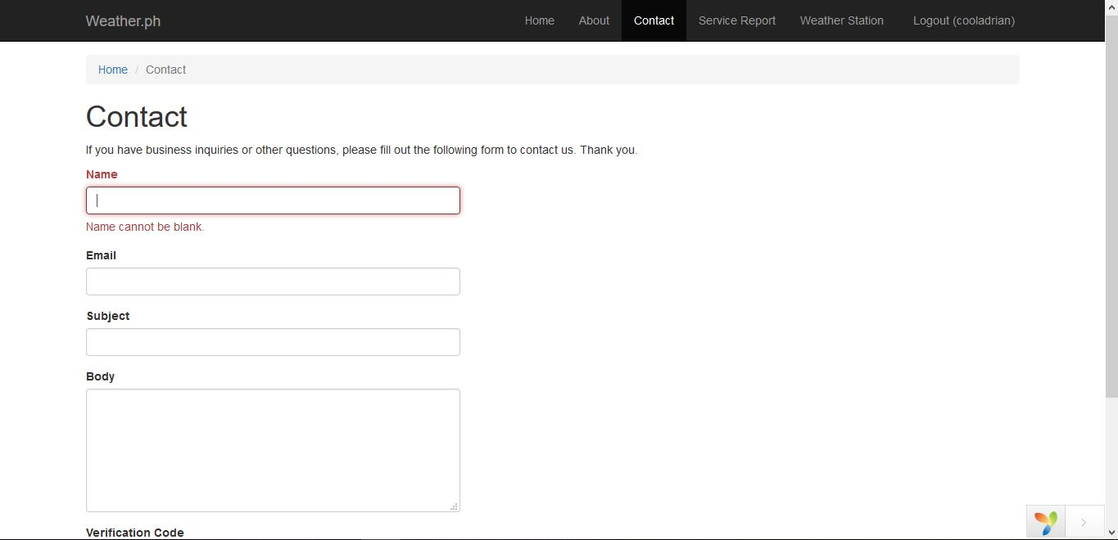

Slide 18
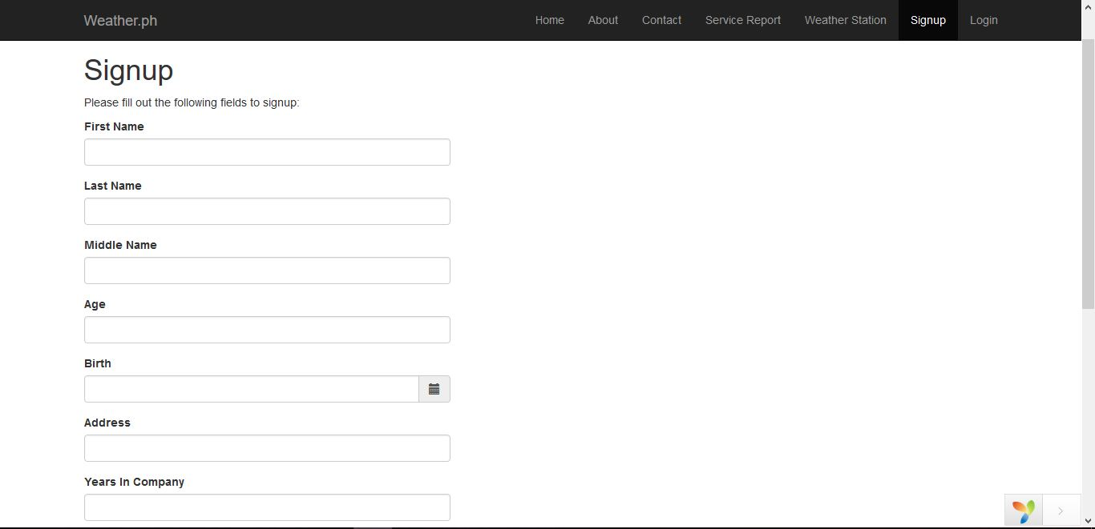

Slide 19
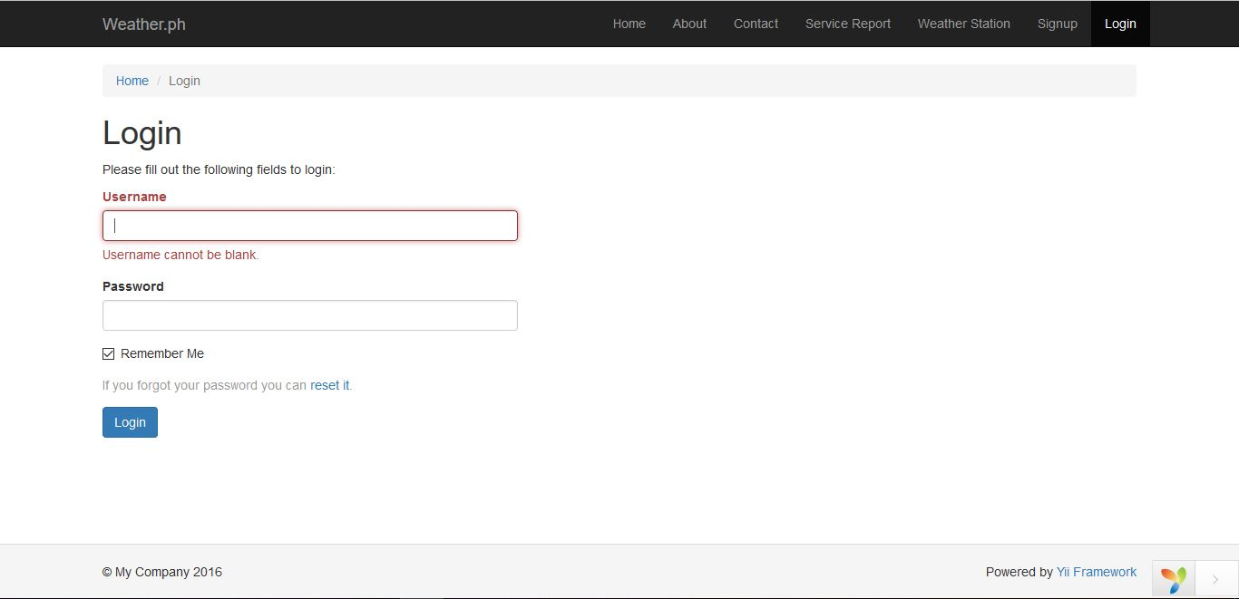

Slide 20
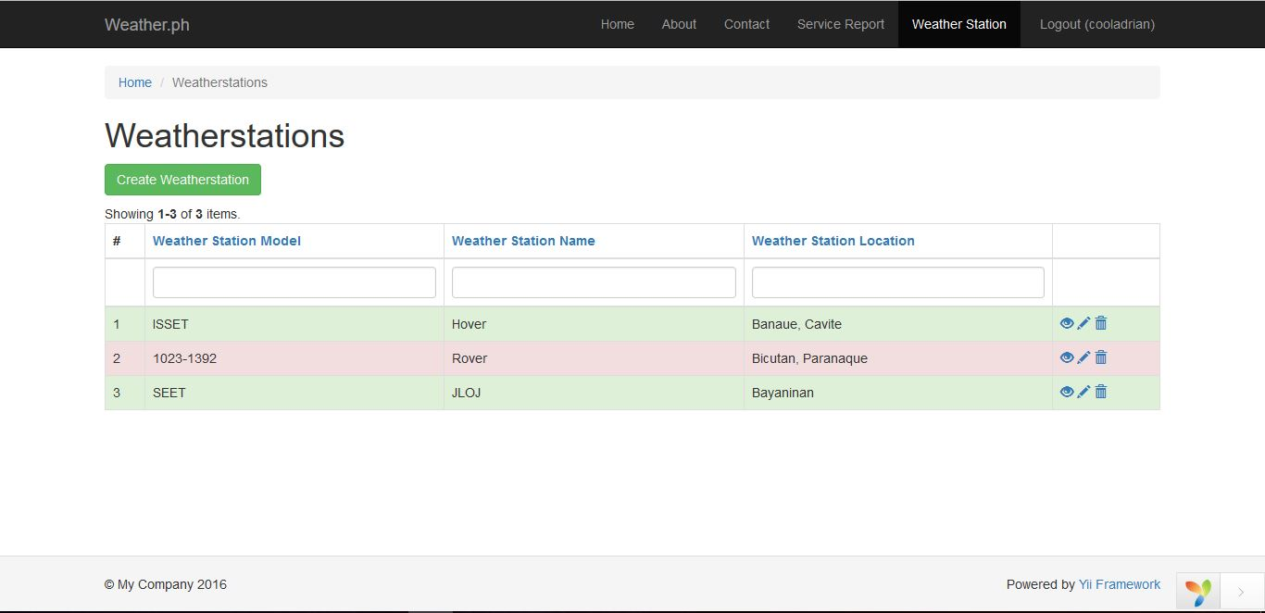
COMMON

Slide 21
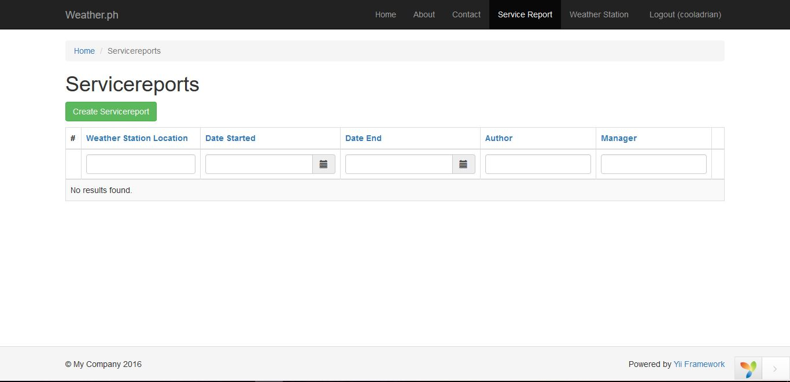

Slide 22
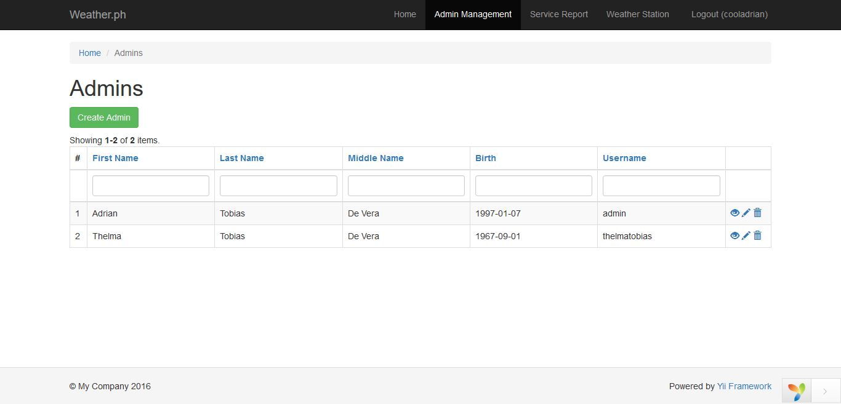
BACKEND

